Slide 1
Thesis Meeting
11/11/2022

Slide 2
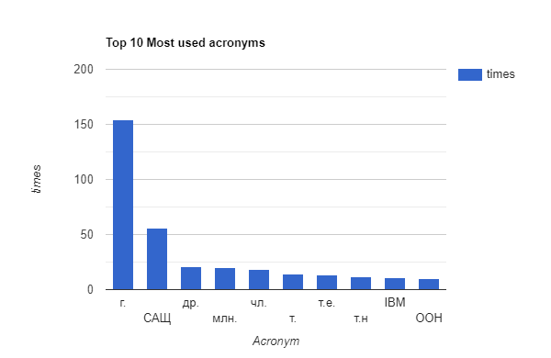
Stats for data
Total unique acronyms = 430
Bulgarian acronyms = 212
English acronyms = 218

Slide 3
Algorithm
Extract all acronyms from the text, store them in a global acronym map
Skip rules
  If the token length is less than 2 characters and not all characters are capital - SH
  If the token is less than 3 characters and the 2nd character is punctuation - SH
  If at least 40% of the characters are not capital letter – Maddog
  If token length is 10 or more characters – Iliya
  To exclude titles
  if first character is not a capital or a digit – Iliya
  digit because of the medical dataset
Separate the text on sentences
Separate the sentences on tokens
Create an acronym map for the sentence
Creates a map of all the acronyms that are available in the sentence with their indexes
Go through each of the acronyms in the maps
  Check if the acronym already have a definition in the global acronym map
  Find the length of the acronym expansion in words
  Get the number of capital letters and the number of small letters that are not concatenated
  Get the first Acronym capital letter and the last acronym capital letter
  Those are supposed to match the first and the last word of the expansion
  Define maximum distance where the expansion could be located - Maddog
  Find the indexes of the first and the last words of the expansion
  Send this part of the sentence for expansion check
    Confirm that the first letter of the first and last word of the expansion match the first and last letter from the acronym
    Check letter matching -> first letters
    Check for stop words
    Check for Acronym in expansion
    Check if the length of the Acronym letters + the number of stop words are less then first letter of the acronym
  Add acronym and expansion to global acronym map
Return the global acronym map

Slide 4
Results
SDU AAAI AI - Dataset
Algorithm | Acronyms in text |  |  | Expansions in text |  |  | Pairs in text |  |  | Dict Acronyms |  |  | Dict Pairs |  |  | Execution Times
Schwartz-Hearst | 0.960206 | 0.823641 | 0.886696 | 0.966999 | 0.79646 | 0.873484 | 0.928519 | 0.79646 | 0.857435 | 0.947988 | 0.826347 | 0.882998 | 0.910697 | 0.793841 | 0.848263 | 0.000026 | 0.000104
MADDOG | 0.986341 | 0.867257 | 0.922973 | 0.982507 | 0.852086 | 0.912661 | 0.969087 | 0.852086 | 0.906828 | 0.984329 | 0.859709 | 0.917808 | 0.963761 | 0.841745 | 0.89863 | 0.1605 | 0.007975
Iliya | 0.920052 | 0.887484 | 0.903475 | 0.982194 | 0.87168 | 0.923644 | 0.90367 | 0.871681 | 0.887387 | 0.912343 | 0.872541 | 0.891998 | 0.889982 | 0.851155 | 0.870136 | 0.00002 | 0.001277
 | Precision | Recall | F1-Measure | Precision | Recall | F1-Measure | Precision | Recall | F1-Measure | Precision | Recall | F1-Measure | Precision | Recall | F1-Measure | per model | per article
Wiki user- Dataset
Algorithm | Acronyms in text |  |  | Expansions in text |  |  | Pairs in text |  |  | Dict Acronyms |  |  | Dict Pairs |  |  | Execution Times
Schwartz-Hearst | 0.91 | 0.705426 | 0.79476 | 0.945055 | 0.666667 | 0.781818 | 0.86 | 0.666667 | 0.751092 | 0.904255 | 0.708333 | 0.794393 | 0.851064 | 0.666667 | 0.747664 | 0.000028 | 0.000465
MADDOG | 0.927835 | 0.697674 | 0.79646 | 0.955556 | 0.666667 | 0.785388 | 0.886598 | 0.666667 | 0.761062 | 0.922222 | 0.691667 | 0.790476 | 0.877778 | 0.658333 | 0.752381 | 0.190727 | 0.086684
Iliya | 0.865169 | 0.596899 | 0.706422 | 0.987013 | 0.589147 | 0.737864 | 0.853933 | 0.589147 | 0.697248 | 0.86747 | 0.6 | 0.70936 | 0.84337 | 0.583333 | 0.689655 | 0.000028 | 0.021245
 | Precision | Recall | F1-Measure | Precision | Recall | F1-Measure | Precision | Recall | F1-Measure | Precision | Recall | F1-Measure | Precision | Recall | F1-Measure | per model | per article
Medstract - Dataset
Algorithm | Acronyms in text |  |  | Expansions in text |  |  | Pairs in text |  |  | Dict Acronyms |  |  | Dict Pairs |  |  | Execution Times
Schwartz-Hearst | 1 | 0.891304 | 0.79476 | 1 | 0.891304 | 0.781818 | 1 | 0.666667 | 0.751092 | 1 | 0.708333 | 0.794393 | 1 | 0.666667 | 0.747664 | 0.000033 | 0.000339
Iliya | 1 | 0.318182 | 0.482759 | 0.642857 | 0.204545 | 0.310345 | 0.642857 | 0.204545 | 0.310345 | 1 | 0.333333 | 0.5 | 0.642857 | 0.214286 | 0.321429 | 0.000033 | 0.007173
 | Precision | Recall | F1-Measure | Precision | Recall | F1-Measure | Precision | Recall | F1-Measure | Precision | Recall | F1-Measure | Precision | Recall | F1-Measure | per model | per article

Slide 5
Next steps
Changes in the algorithm from this week
Do more statistics
Fix Annotation dataset

